Slide 1

The Price of Policing: Uncovering Local Economic Divides in Stop and Search
Kofi Barton-Byfield
23475742

Slide 2

Background
Definition of Stop & Search
A Policing Policy that allows police to stop, detain and search individuals if they have suspicion the individual committed a crime.
an officer has reasonable grounds for suspicion that a person is in possession of a stolen or prohibited item, or controlled drugs, or if a person is in an area where serious violence is anticipated.
There are several powers of search, but majority of powers used are included in:
section 1, Police and Criminal Evidence Act 1984
section 23, Misuse of Drugs Act 1971
section 60, Criminal Justice and Public Order Act 1994

Slide 3

Motivation
Stop and Search (S&S) is one of the UK’s most controversial police powers
Low conviction rates raise questions about its effectiveness
Evidence of ethnic disproportionality fuels public distrust
Research is largely London-focused and race-oriented
This study shifts focus to economic inequality
and regional context
Notes:
S&S functions as a tool for maintaining social order rather than solely for crime deterrence.

Slide 4
Research Question
“To what extent do the spatial patterns of stop and search in Merseyside and Greater London, reflecting their differing social compositions, correlate with localised economic disparities at the LSOA level?”
AIM: to assess whether economic inequality plays a distinct role in stop and search deployment across two very different urban contexts.
How this economic inequality varies in different cultural make-ups

Slide 5
Hypotheses
Hypothesis 1: S&S rates will correlate with higher income deprivation at the LSOA level.
Hypothesis 2: The strength of this correlation will vary significantly between London and Merseyside.
Hypothesis 3: The interaction between income deprivation and ethnic diversity will show that economically deprived, ethnically diverse areas face the highest levels of S&S activity.

Slide 6
Data Sources
Stop & Search data (2022)
Economic inequality measures:
Income Deprivation
Median house prices

Slide 7
Methods
Descriptive spatial analysis:
Mapping S&S rates across LSOAs to visualise clustering
Regression models:
S&S rate (dependent variable) vs income deprivation, house prices, etc.
Compare coefficients for London and Merseyside separately

Slide 8
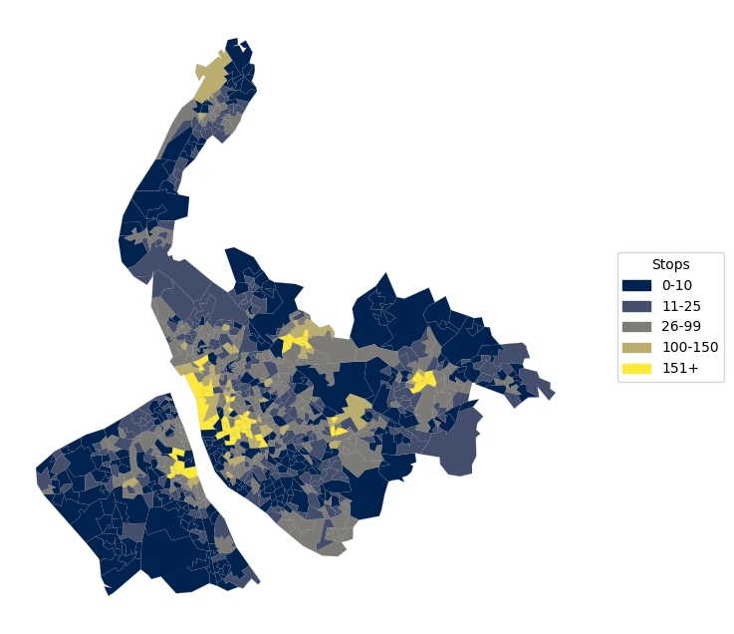
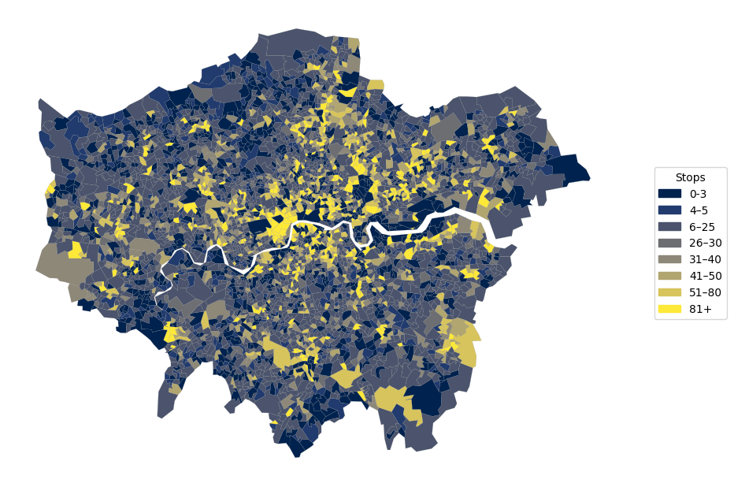
Preliminary Analysis – Stop & Search

Slide 9
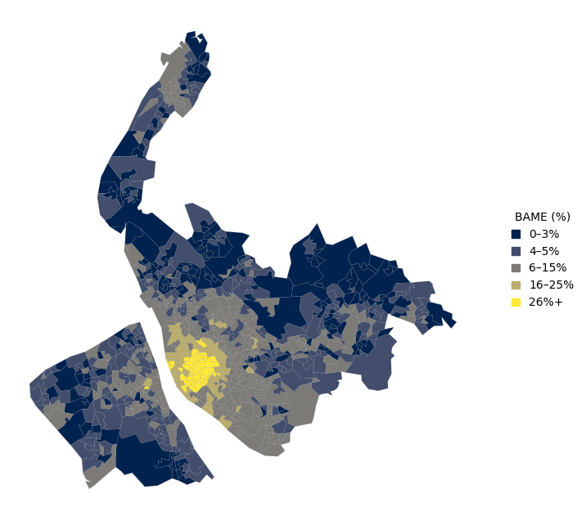
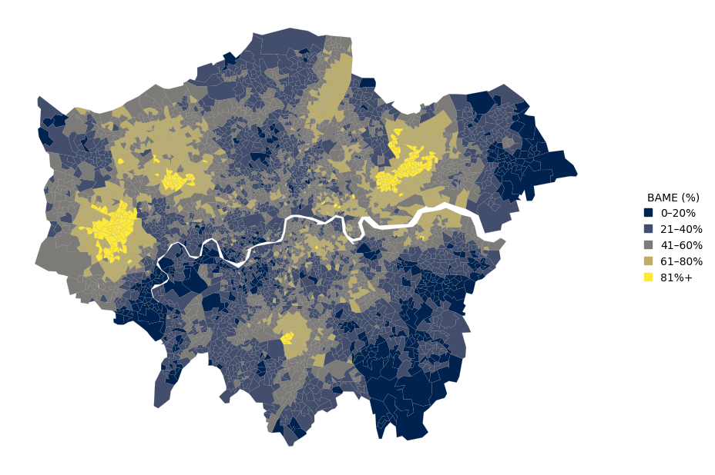
Preliminary Analysis – BAME %

Slide 10
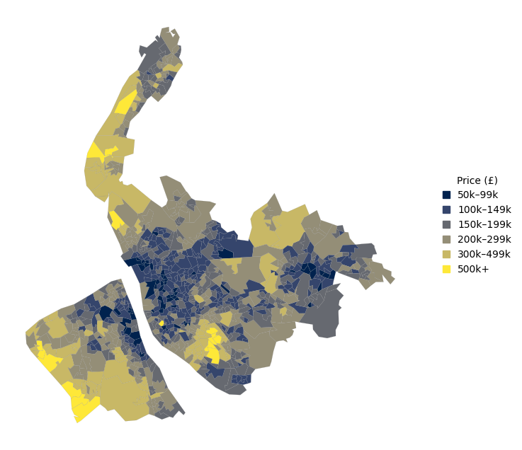
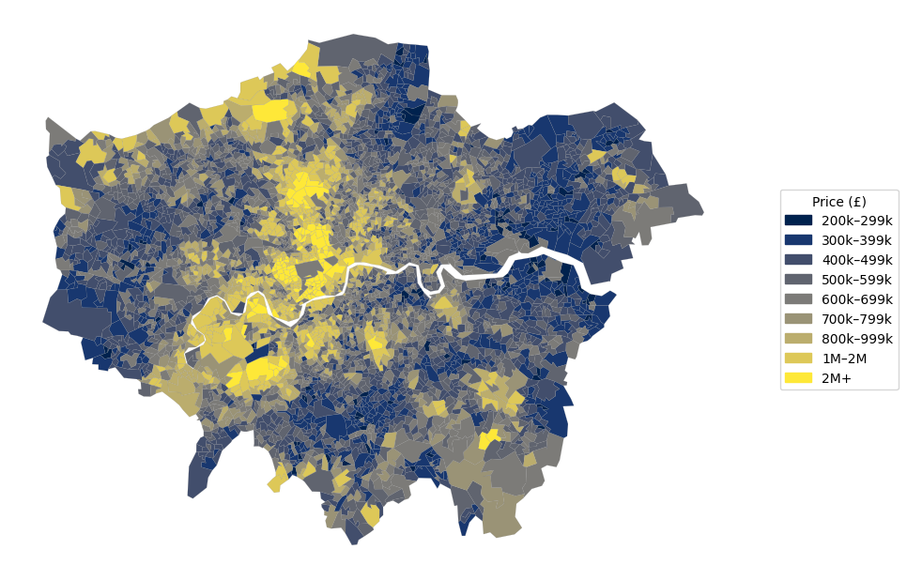
Preliminary Analysis – House Price

Slide 11
Next Steps
Cleaning the data
1
Run full regression models with controls
2
Conduct robustness checks
3
Interpret comparative results and begin writing
4

